Slide 1
Azure Storage Service
Blob
Presenter: HaoJing

Slide 2
Contents
01
02
03
04
05
Overview
Storage Account
Redundancy
Blob Storage
Access Tier

Slide 3
01. Overview

Slide 4
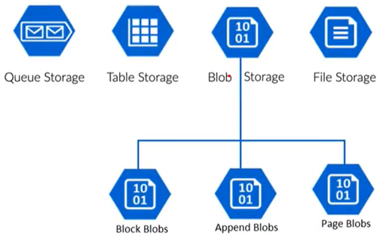
Different Type of Data Service
Azure Blob: A massively scalable object store for text and binary data.
1
Azure Files: Managed file share for cloud or on-premises deployments.
2
Azure Queues: Messaging store for reliable messaging between application components.
3
4
Azure Tables: NoSQL store for schemaless storage of structured data

Slide 5
Data Service Features
Durable and highly available Redundancy ensures that your data is safe in the event of transient hardware failures. You can also opt to replicate data across data centers or geographical regions for additional protection from local catastrophe or natural disaster. Data replicated in this way remains highly available in the event of an unexpected outage.
Secure All data written to an Azure storage account is encrypted by the service. Azure Storage provides you with fine-grained control over who has access to your data.
Scalable Azure Storage is designed to be massively scalable to meet the data storage and performance needs of today's applications.
Managed Azure handles hardware maintenance, updates, and critical issues for you.
Accessible Data in Azure Storage is accessible from anywhere in the world over HTTP or HTTPS. Microsoft provides client libraries for Azure Storage in a variety of languages, including .NET, Java, Node.js, Python, PHP, Ruby, Go, and others, as well as a mature REST API. Azure Storage supports scripting in Azure PowerShell or Azure CLI. And the Azure portal and Azure Storage Explorer offer easy visual solutions for working with your data.

Slide 6
02. Storage Account

Slide 7
Storage account overview
Storage data objects:
Azure Blob , Azure files, Azure queues, Azure tables
Storage account feature:
Durable and highly available, secure, and massively scalable.
Provides a unique namespace for your Azure Storage data that's accessible from anywhere in the world over HTTP or HTTPS

Slide 8
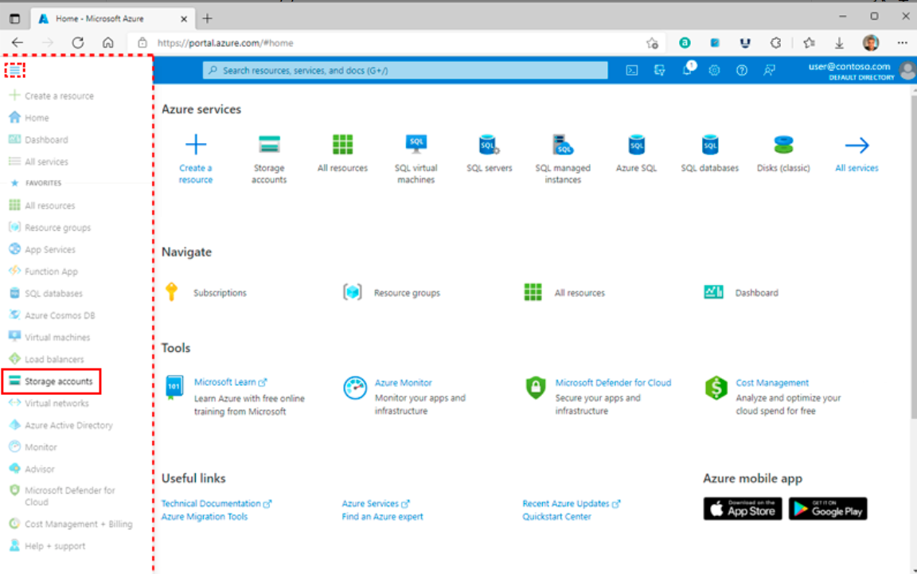
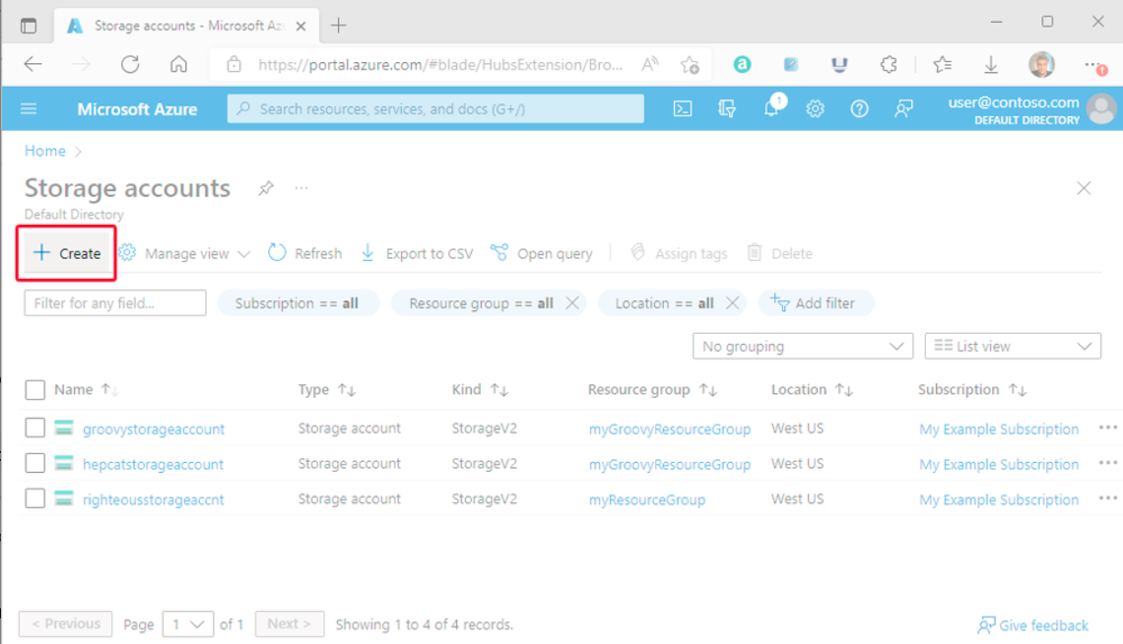
Create storage accounts

Slide 9
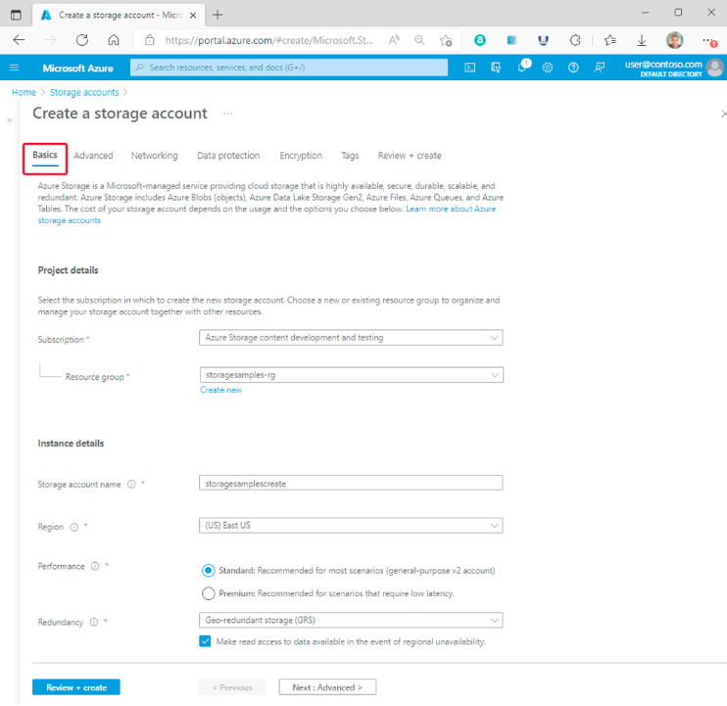
Basics Tab
Field (Required) | Description
Subscription | Select the subscription for the new storage account.
Resource group | Create a new resource group for this storage account or select an existing one. For more information
Storage account name | Unique name 3 and 24 characters in length contain numbers and lowercase letters only
Region | Select the appropriate region for your storage account
Performance | Standard: general-purpose v2 storage Premium: low latency
Redundancy | Select your desired redundancy configuration

Slide 10
Types of storage accounts
Note: You can't change a storage account to a different type after it's created. To move your data to a storage account of a different type, you must create a new account and copy the data to the new account.
Type of storage account | Supported storage services | Redundancy options
Standard general-purpose v2 | Blob Storage(including Data Lake Storage) Queue Storage Table Storage Azure Files | Locally redundant storage (LRS) geo-redundant storage (GRS) geo-redundant storage (RA-GRS)(read-access) Zone-redundant storage (ZRS) geo-zone-redundant storage (GZRS) geo-zone-redundant storage (RA-GZRS) (read-access)
Premium block blobs | Blob Storage(including Data Lake Storage) | LRS ZRS
Premium file shares | Azure Files | LRS ZRS
Premium page blobs | Page blobs | LRS ZRS

Slide 11
03. Redundancy

Slide 12
Azure Storage Redundancy
Protected your data from hardware failures, network or power outages, and massive natural disasters.
Even in the face of failures, redundancy ensures that your storage account meets its availability and durability.
Tradeoffs between lower costs and higher availability.
Redundancy in the primary region
Locally redundant storage (LRS) - Three synchronous copies in a single physical location (本地冗余存储)
Zone-redundant storage (ZRS) - Three synchronous copies in three availability zones (AZs) (区域冗余存储)
Redundancy in a secondary region
Geo-redundant storage (GRS) – LRS + Asynchronously copy to secondary region (异地冗余存储)
Geo-zone-redundant storage (GZRS) – ZRS + Asynchronously copy to secondary region (异地区域冗余存储)
With GRS or GZRS, the data in the secondary region isn't available for read or write access unless there's a failover to the primary region.
For read access to the secondary region, configure your storage account to use
Read-access geo-redundant storage (RA-GRS)
Read-access geo-zone-redundant storage (RA-GZRS)

Slide 13
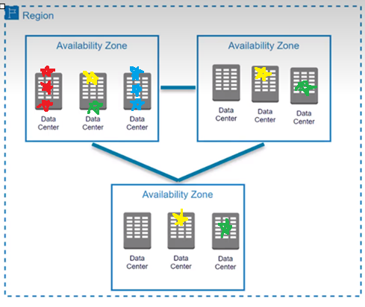
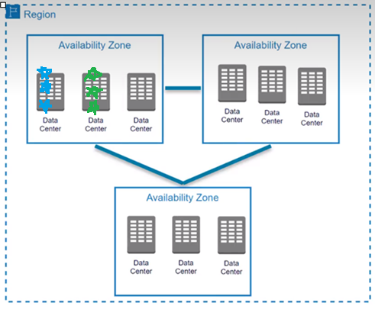
Azure Storage Redundancy
Locally redundant storage (LRS) - Three synchronous copies in a single data center (本地冗余)
Zone-redundant storage (ZRS) - Three synchronous copies in three availability zones (AZs) (区域冗余)
Geo-redundant storage (GRS) – LRS + Asynchronously copy to secondary region(three more copies using LRS) (异地冗余)
Geo-zone-redundant storage (GZRS) – ZRS + Asynchronously copy to secondary region(three more copies using LRS) (异地区域)

Slide 14
04. Blob Storage

Slide 15
Blob Storage
Blob: Binary Large Object
Any type or format
Text, Image, audio, video, excel, backup files
Use case:
Serving images or documents directly to a browser.
Storing files for distributed access.
Streaming video and audio.
Writing to log files.
Storing data for backup and restore, disaster recovery, and archiving.
Storing data for analysis by an on-premises or Azure-hosted service.

Slide 16
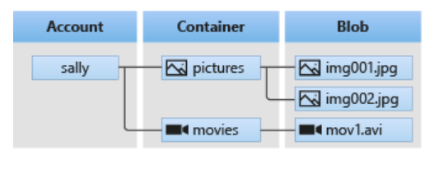
Blob Structure
Three types of resources
The storage account
A container in the storage account
A blob in a container
Relationship Diagram(Flat structure)

Slide 17
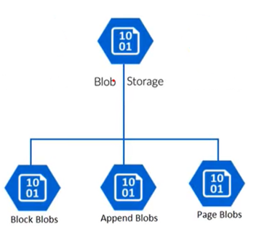
Three Types of Blob Storage
Block blobs
Doesn’t use random read and write operations.
Files that are read from beginning to end.
Such as media files or image files for websites
Page blobs
Optimized for random read and write operations.
Provide durable disks for Azure Virtual Machines.
Append blobs
Optimized for append operations. e.g. Logs
Modify, added to the end of the blob only.
Update, delete for existing blocks is not supported.

Slide 18
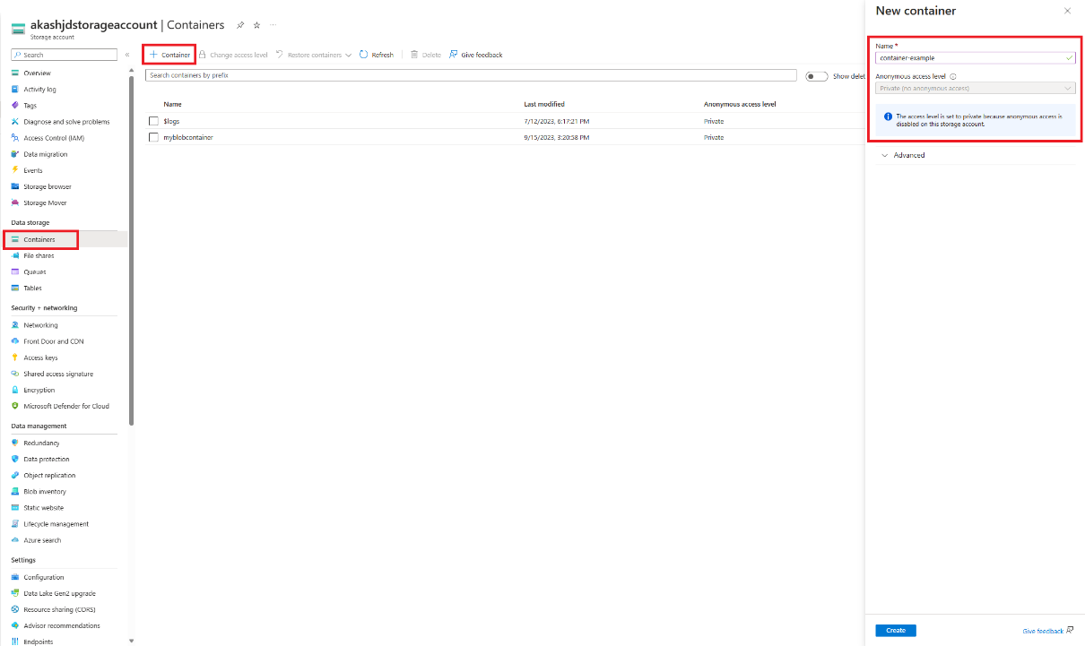
Create a container
Steps:
In the Azure portal
Scroll to the Data storage section
Select Containers
Select the + Container button
Set the level of anonymous access
(default level is Private)
Select Create
Naming conventions:
must be lowercase
must start with a letter or number
only letters, numbers, and the dash (-)
3 through 63 characters long

Slide 19
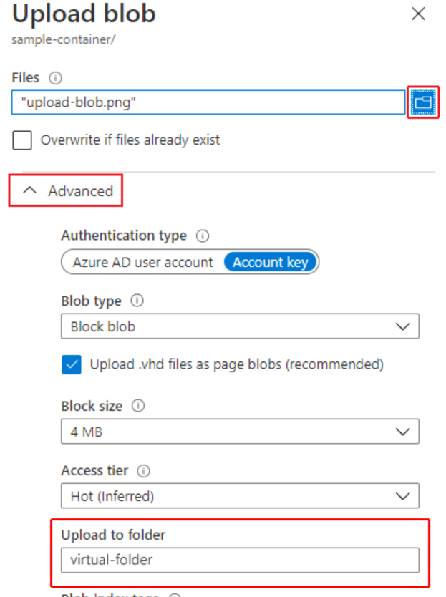
Upload a block blob
Steps:
Select the container
Select the Upload button
You can optionally expand the Advanced section to configure other settings
Naming conventions:
Any combination of characters
Case-sensitive
1 through 1024 characters long
Note: Avoid blob names that end with a dot (.), a forward slash (/), a backslash (\), or a sequence or combination of the two.

Slide 20
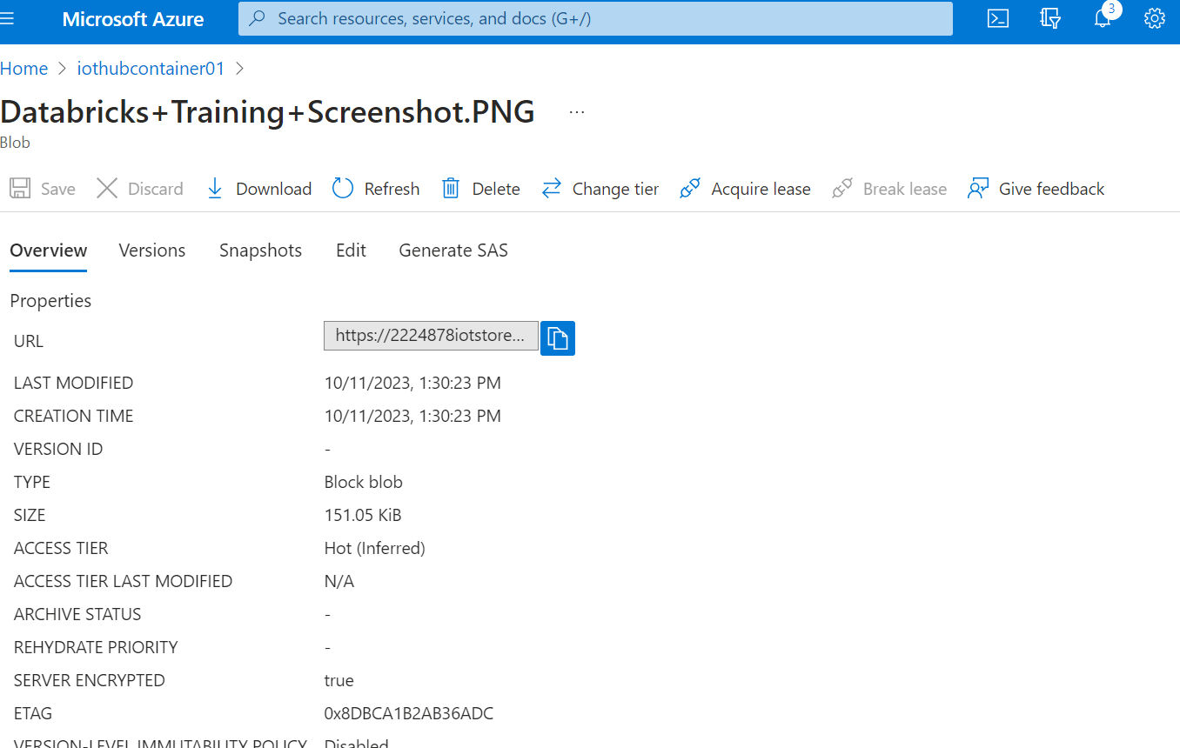
Blob Screenshot
Provide a unique namespace in Azure for your data
https://2224878iotstore01.blob.core.windows.net/iothubcontainer01/Databricks+Training+Screenshot.PNG

Slide 21
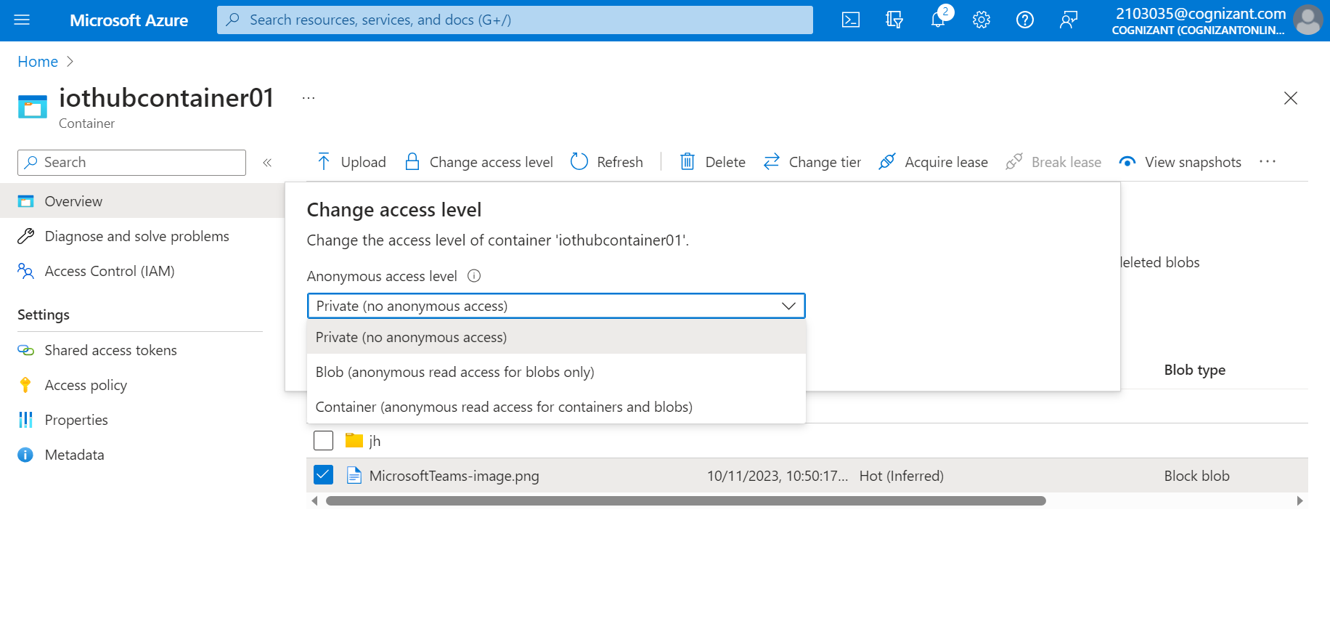
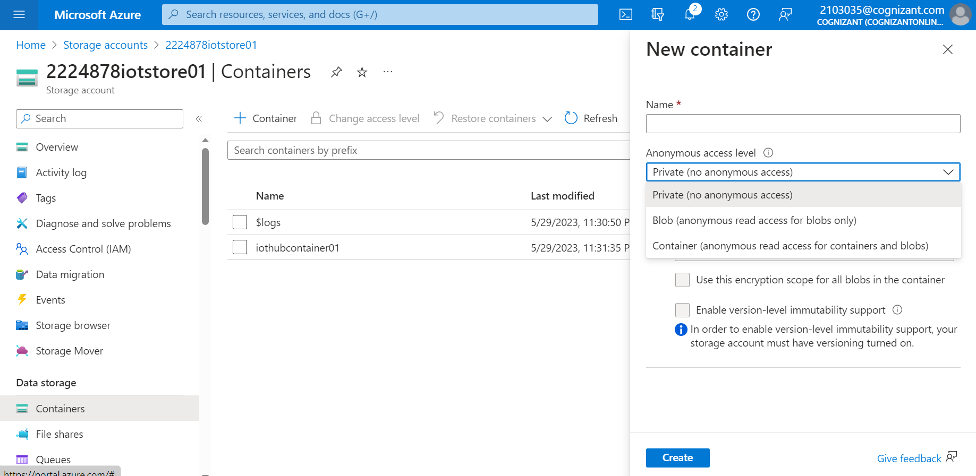
Question: Access Level / Block Folder

Slide 22
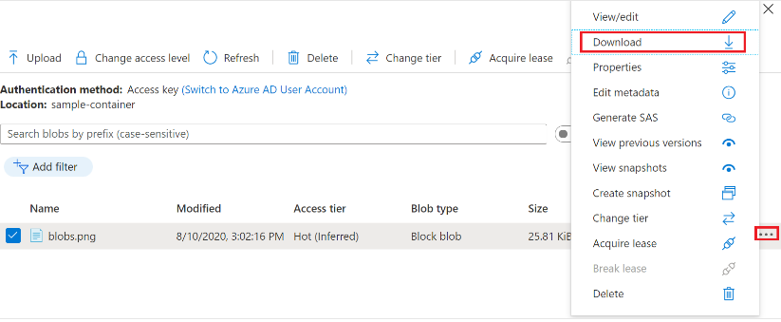
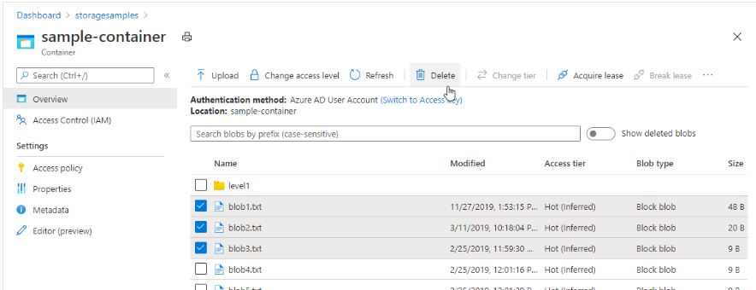
Download/Delete a block blob
Steps:
Navigate to the list of blobs that you uploaded in the previous section.
Right-click the blob you want to download
Select Download
Steps:
Navigate to container.
Display the list of blobs in the container
Use the checkbox to select one or more blobs from the list
Select the Delete button

Slide 23
Blob Storage vs. Data Lake Storage Gen2
Advanced Tab
Enable hierarchical namespace
Aspect | Azure Data Lake Storage Gen2 | Blob Storage
Storage architecture | Based on the Hadoop Distributed File System (HDFS). | Object storage.
Access patterns | Supports directory and file-based access, and complex querying using various query engines such as Spark and Hive. | Suitable for storing massive amounts of unstructured data and provides simple read and write operations over HTTP/HTTPS.
Data access control | Provides finer-grained permission control based on directories and files. | Uses simple storage-level access control, such as private or public access.
Cost | Provides more extensive data management and analysis features, but costs may be higher. | Usually lower storage costs.

Slide 24
05. Access Tier

Slide 25
Storage Access Tiers
Hot
Data store in the cloud can be different based on how it’s generated, processed and accessed over its lifetime.
Pricing
Cool
The volume of data stored/month
Type of operations performed
Number of operation performed
Data transfer cost, if any
The selected data redundancy option
Cold
Archive
Organize your data based on attributes like frequency of access and planned retention period

Slide 26
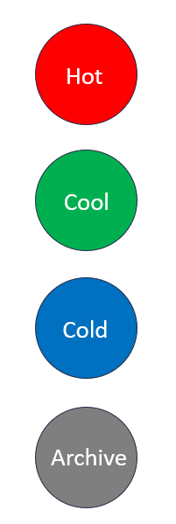
Storage Access Tiers
Note: Setting the access tier is only allowed on Block Blobs. They are not supported for Append and Page Blobs.
The cold tier and the archive tier are not supported as the default access tier for a storage account.
Hot
Frequently accessed data
Low latency
Higher access cost
Cool
Infrequent accessed data
High latency
lower storage costs and higher access costs than Hot
Stored for at least 30 days
Cold
Infrequent accessed data
High latency
lower storage costs and higher access costs than Cool
Stored for at least 90 days
Archive
Rarely accessed data
Highest access times and access cost
Stored for at least 180 days
Fast Access
Higher Cost
Slow Access
Lower Cost

Slide 27
Thanks！

